Slide 1


New L. J. Institute of Engineering and Technology
Gujarat Technological University, Ahmedabad
Exploring Emerging Technologies
“YOUTH EMPLOYMENT OPPORTUNITIES”
Head of Department
Dr. Gayatri Pandi
Guided by
Prof Mohit Patel
Prepared by
Unnati Jagdish Parikh (201430142005)
Diya Rakeshkumar Bodiwala (201430142062)
Kshiti Pranav Mulani (201430142077)
Shashvi Kaushalbhai Shah (201430142127)

Slide 2
INTRODUCTION
Unemployment means wastage of precious labour resources of the country.
With the increase in school and college enrolment rates, the proportion of youth in the labour force has been declining.
Youth Employment Opportunities project discusses the unemployment issue which covers a large part of India. It discusses the problems faced by the youth in rural areas due to lack of proper knowledge and guidance.

Slide 3
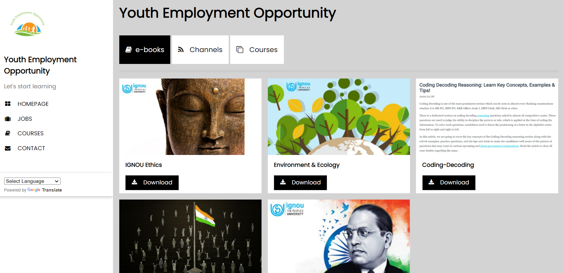
OBJECTIVE OF PROJECT
The main aim of this project is to create a user-friendly and language compatible website for the people of rural areas to help them with the employment issues that they might face.
In this context, the project offers recommendations for increasing productive employment and reduction in unemployment for the youth.

Slide 4
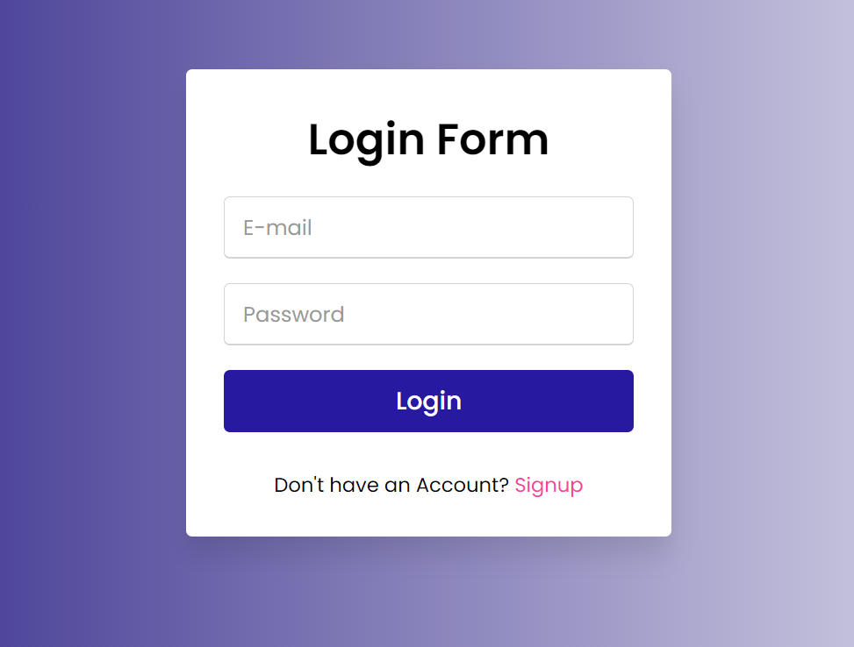
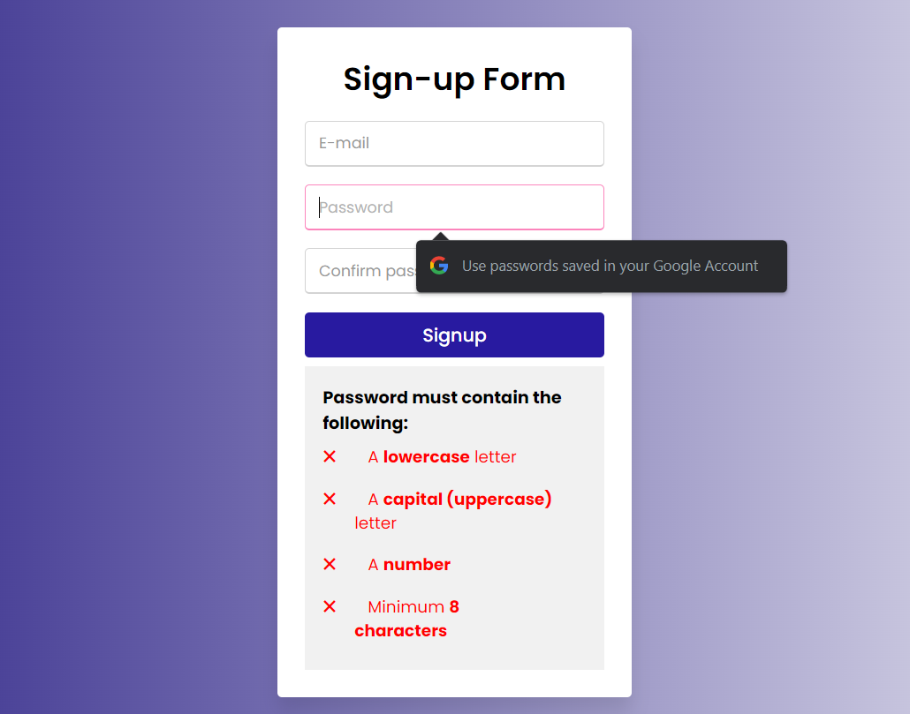
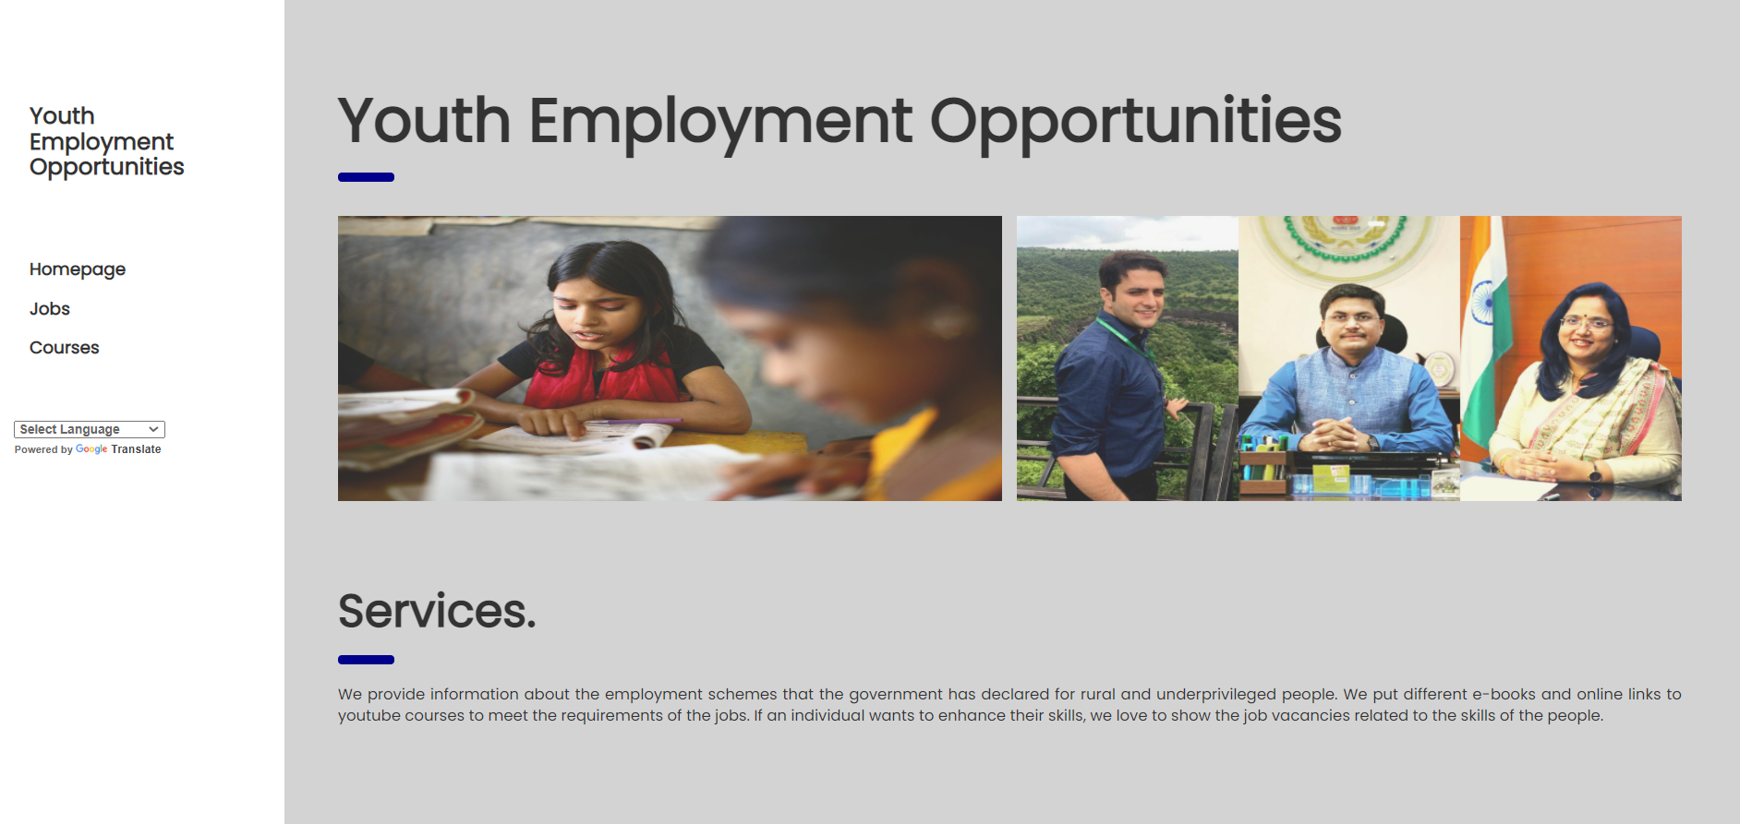
SOME SNAPS FROM OUR WORK
Login Page
Homepage

Slide 5
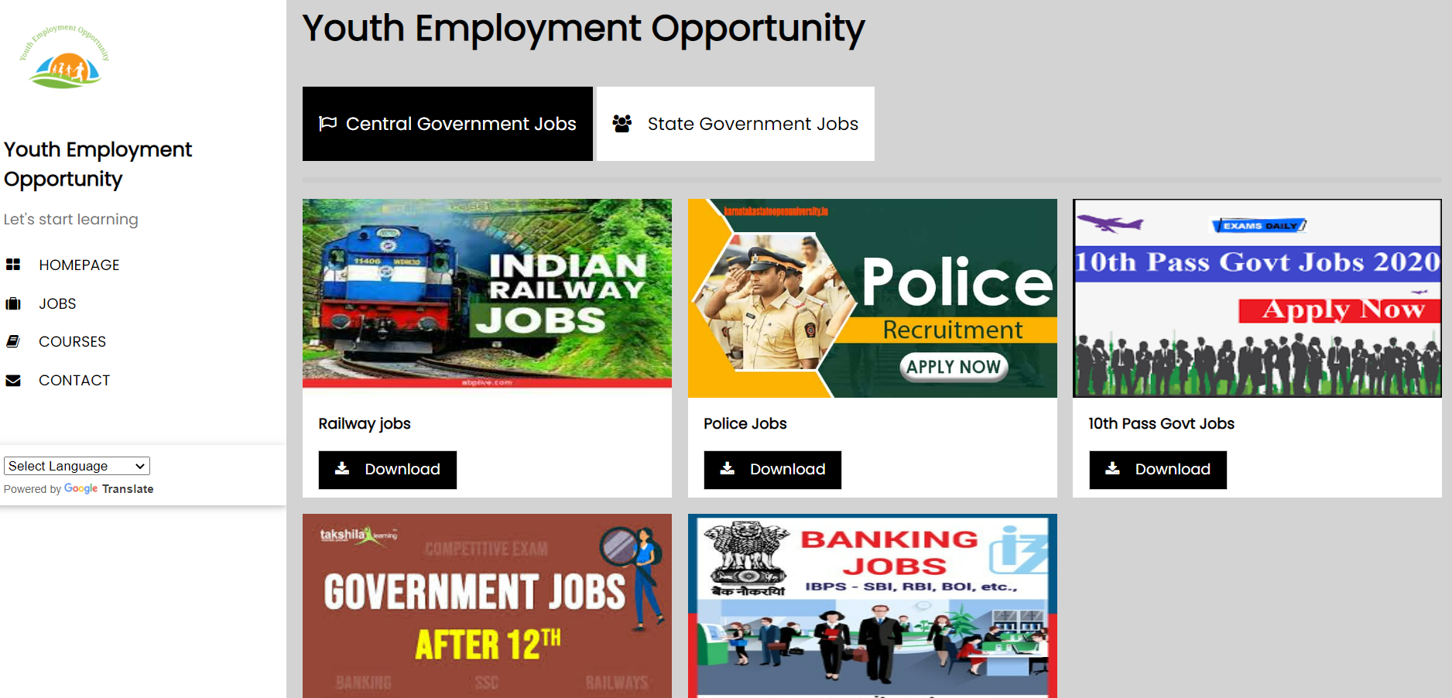
SOME SNAPS FROM OUR WORK
Job Details
Course Details

Slide 6
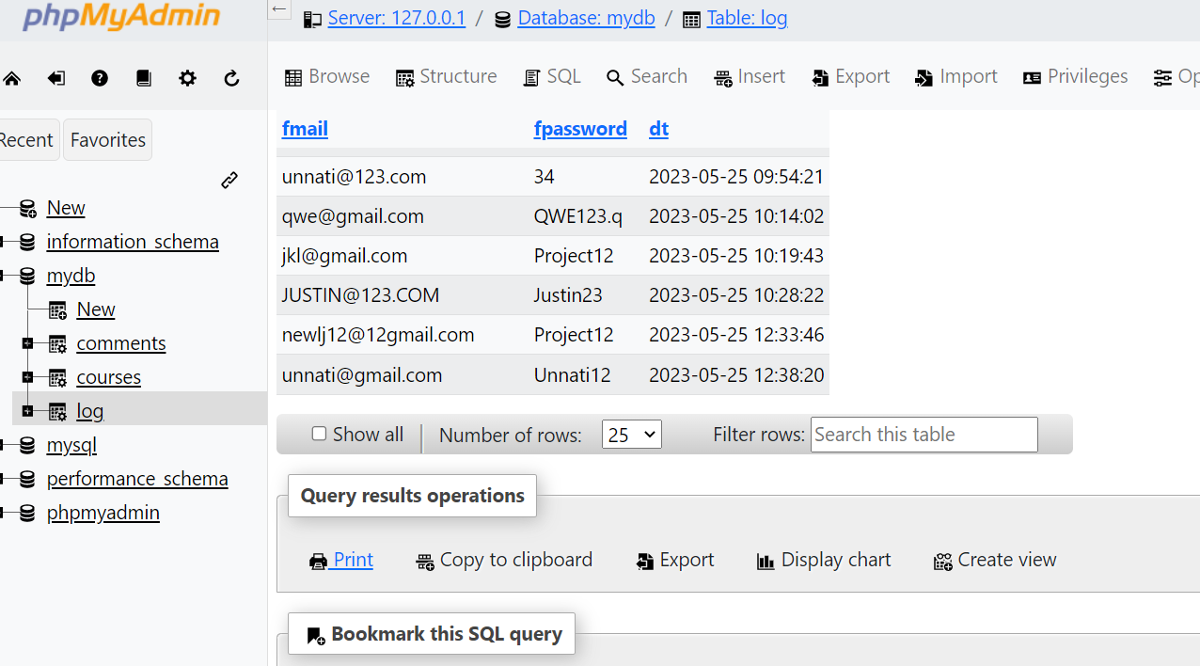
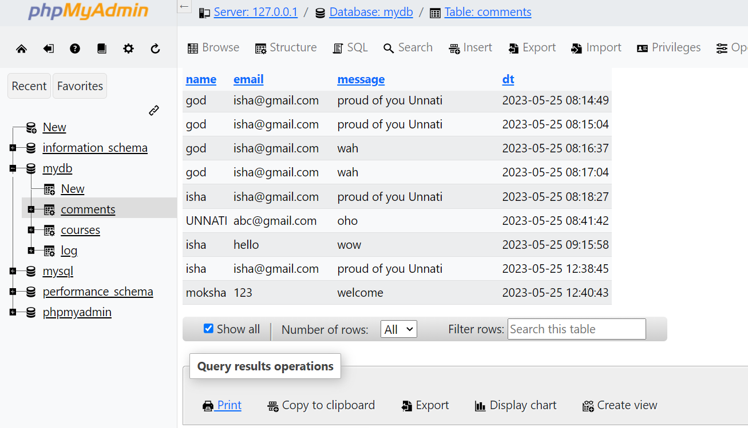
SOME SNAPS FROM OUR WORK
BACKEND FOR LOGIN-SIGNUP
COMMENTS

Slide 7
EXISTING SIMILAR PROJECTS / APPLICATION STUDY
Indeed :- It posts listings for job seekers in every industry, every level, and every lifestyle like freelance, part-time, internship or full-time. Indeed uses more than 130 technologies including HTML5, Google Analytics and jQuery.
Monster :- This site also offers salary comparison and research tools and provides premium resume makeups.
LinkedIn:- This site acts as a database for open opportunities, a digital resume platform, and an all in-one social networking tool. It is also one of the most popular sites for finding a suitable job in recent times. The technologies used in LinkedIn are mostly Java with some Python, Ruby, Node and C++.
However, the gap/issue in these sites is that most of these websites offer more specialized or niche jobs which may not be suitable for every candidate , in every industry, skill level and pin code.

Slide 8
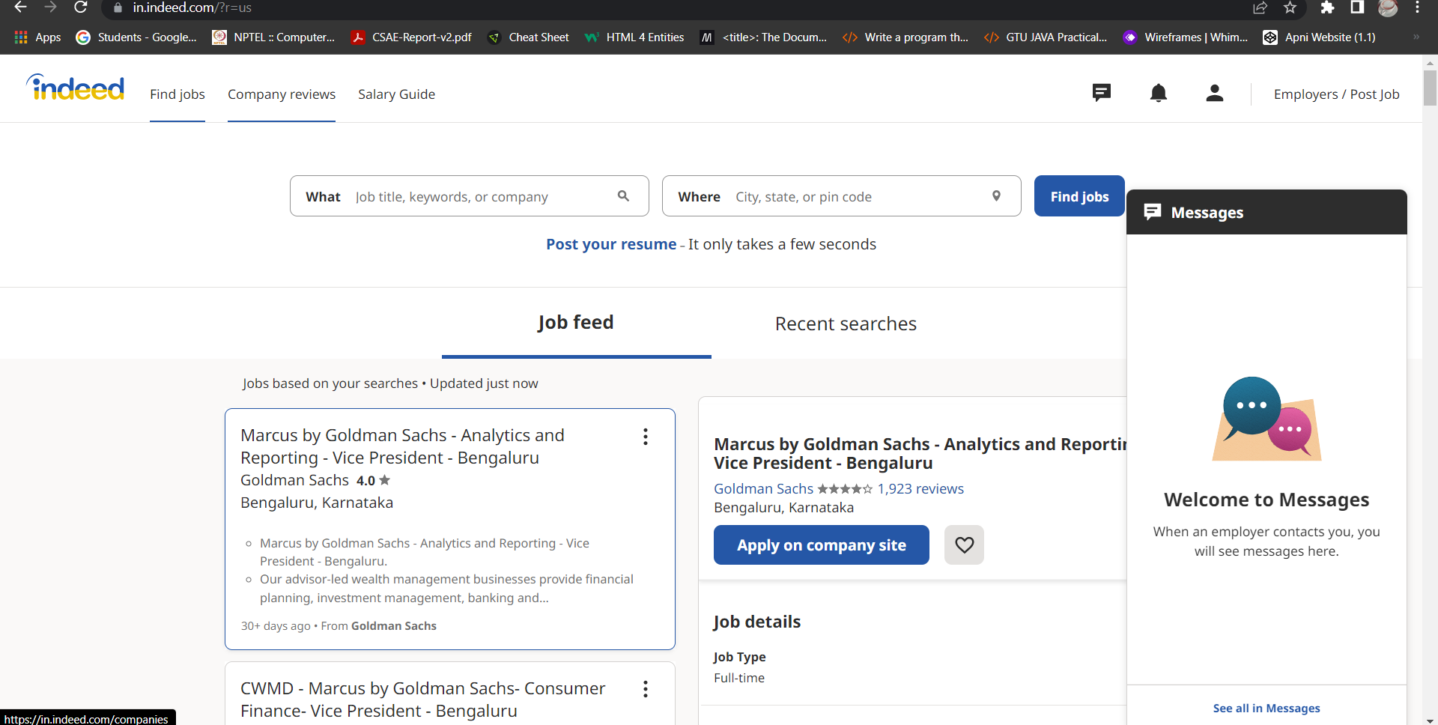
Indeed Interface
Part-1

Slide 9
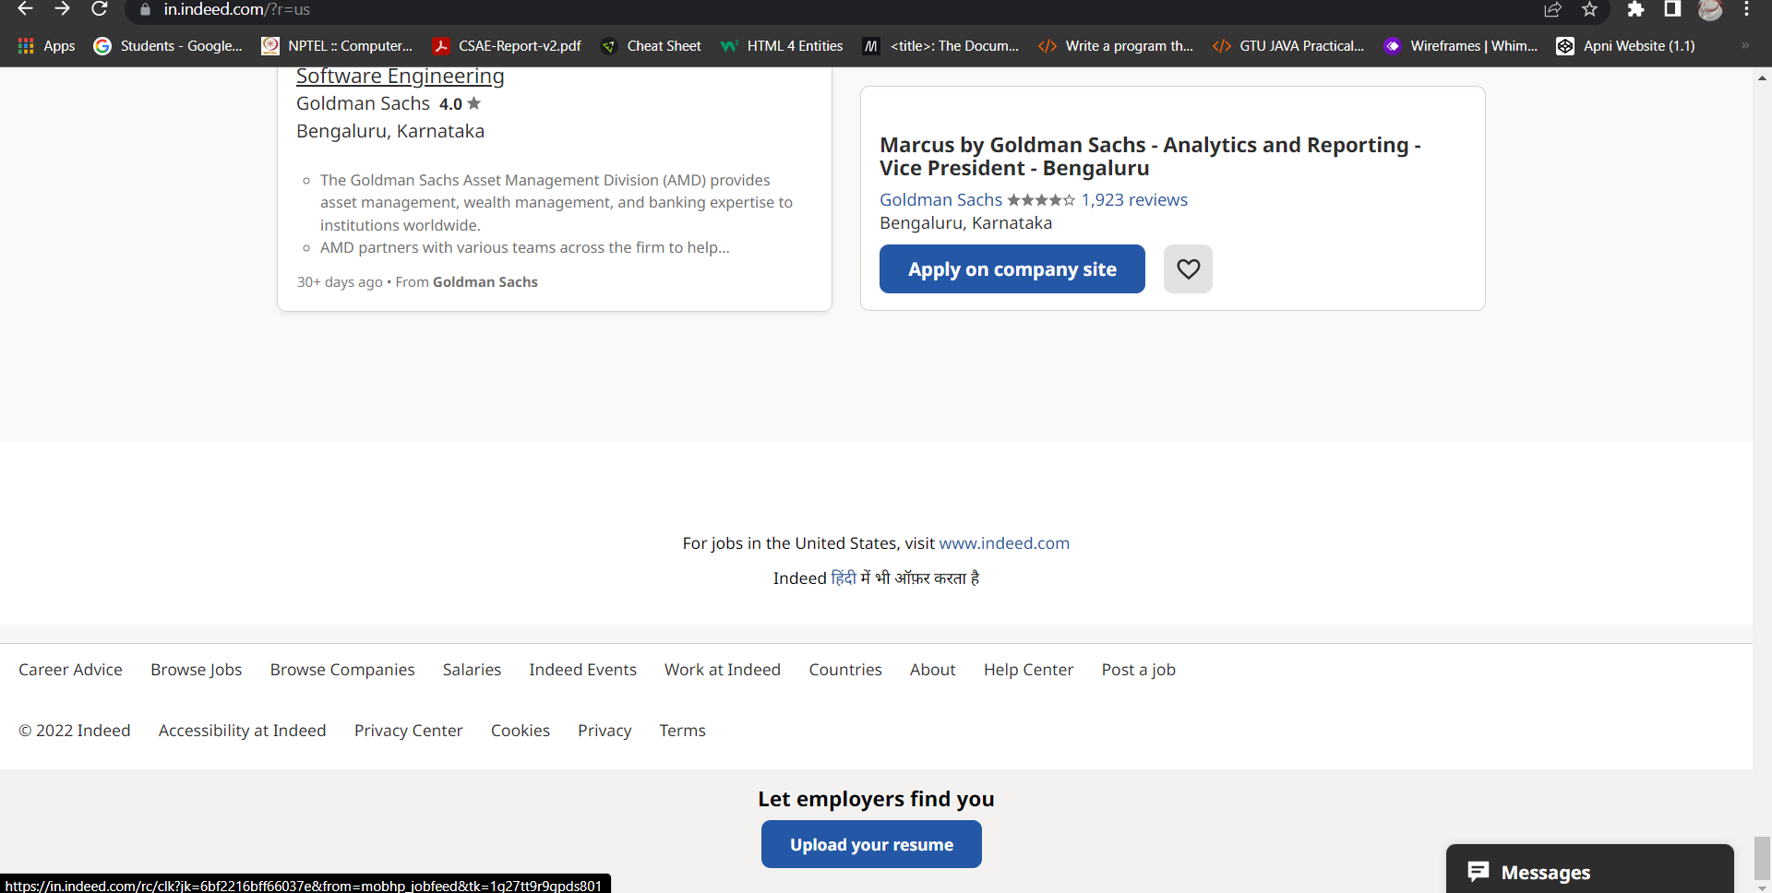
Indeed Interface
Part-2

Slide 10

LinkedIn Interface
Desktop View

Slide 11
RESEARCH GAP
Sr no. | Paper Title | Paper Author | Published Year | Summary
1 | The evidence is in: How should youth employment programs in low-income countries be designed? | Louise Fox and Upasana Kaul | 2017 | This research examines the barriers to youth transitioning into work in low-income nations. It looks at which employment initiatives and policies appear to help youth make the transition faster, with a focus on establishing new job opportunities for them. ^{[3]}
2 | Opinion of youth on issues and challenges related to Employment: A study in Mysore city | Dr Mohan A.K | 2016 | Unemployment rates are normally considered as employment inadequacy for youth. In India, from 2000-to 2010 the share of employment in the industry and service sector continued to grow while agriculture employed fewer workers. Poor quality of educational services is producing a workforce lacking the basic knowledge and skills needed for today's job. ^{[4]}
3 | Challenges Of Decent Employment In India | Shamim Ara | 2021 | This article examines employment challenges in India in the ILO’S decent work framework. Remarkably, jobs were created in the organized sector, in the regular salary category, and in the services sector in 2017-18. However, the rate of employment growth in these segments is very low and cannot offset the net loss of employment in the unorganized sector, temporary jobs and agriculture and manufacturing, particularly in rural areas. The article advocates for urgent policy interventions to ensure access to productive and decent work for all in India. ^{[5]}

Slide 12
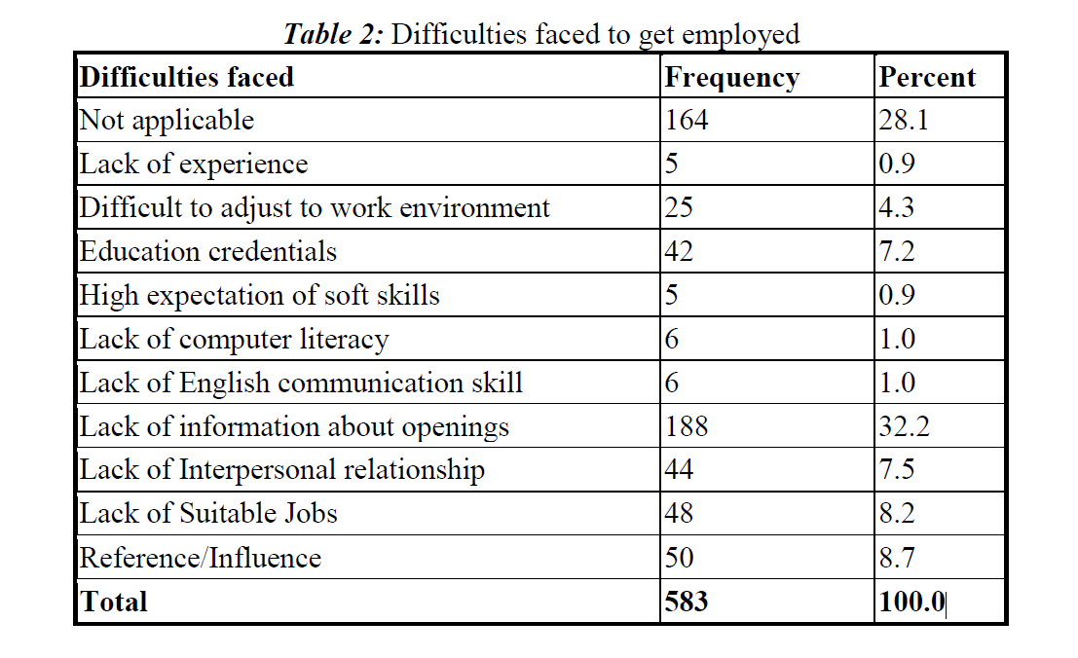
Problem Summary
Although with the increase in literacy among people, the proportion of youth in the labour force has been declining, the problem of youth unemployment and underemployment would remain a serious issue in India for many years to come.
Here, through this project, we show various job openings as well as the sources through which the dream jobs can be acquired.
The language selection is an add-on to reach maximum people.
The table given here shows the difficulties faced in the way of getting jobs.[4]

Slide 13
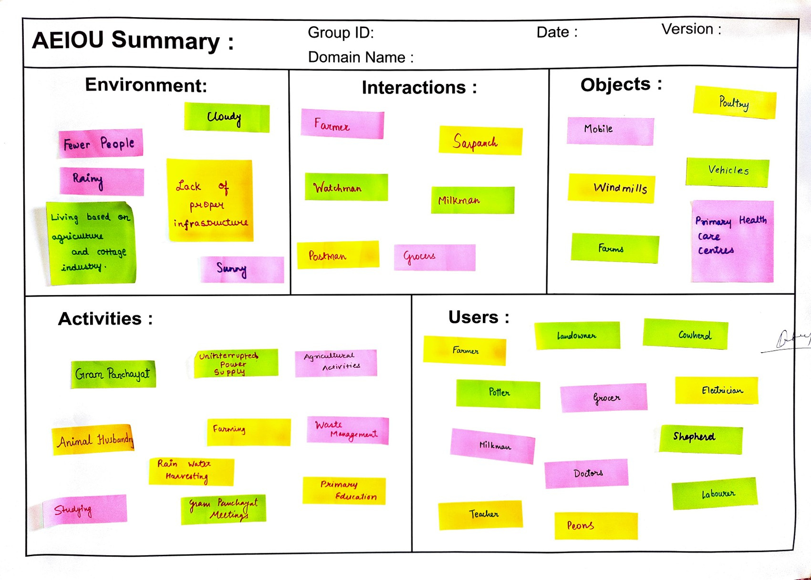
AEIOU CANVAS

Slide 14
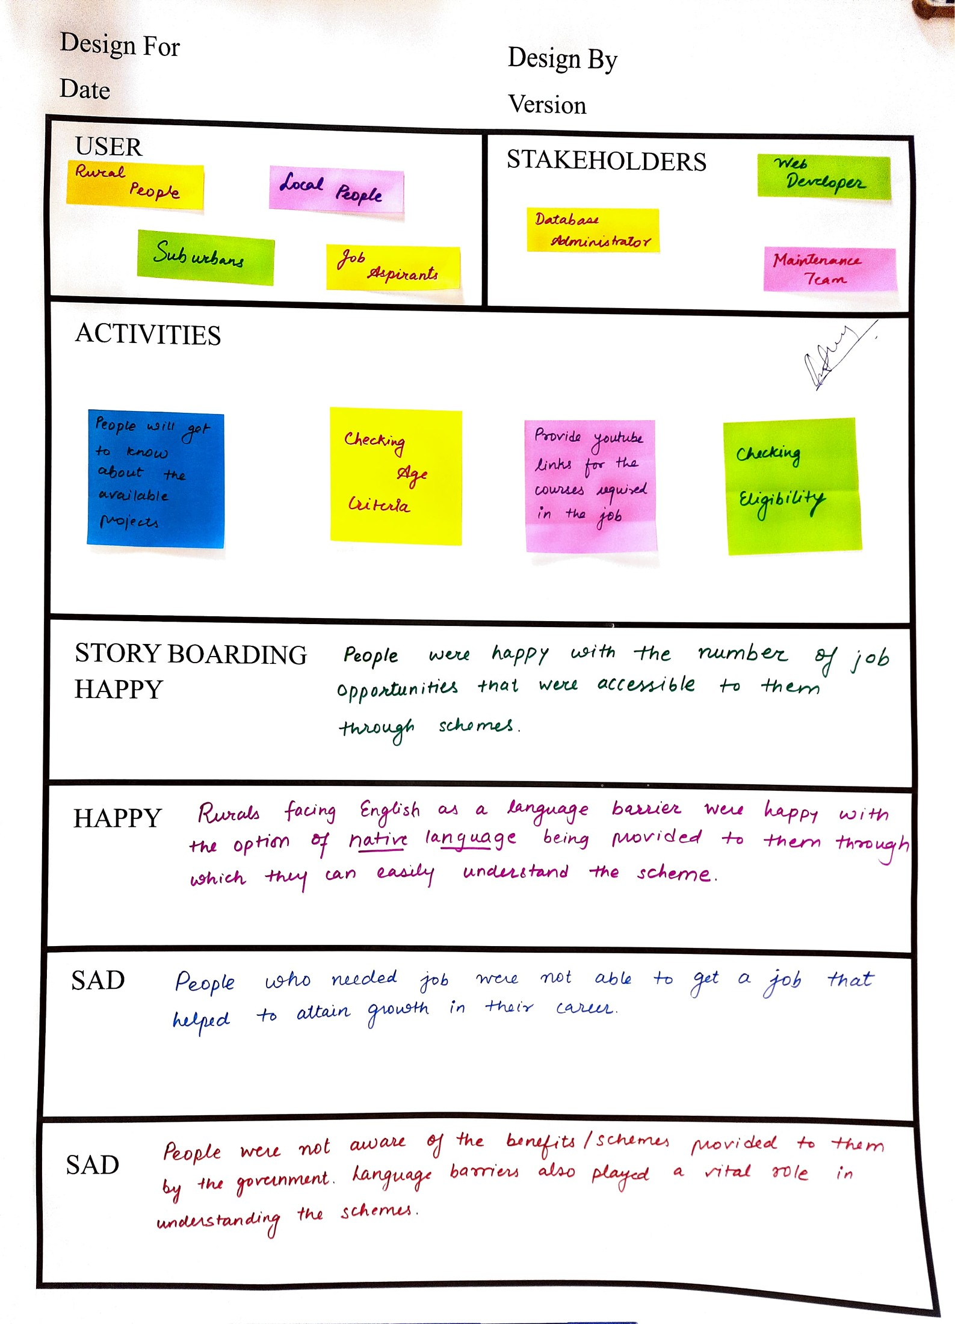
EMPATHY CANVAS

Slide 15
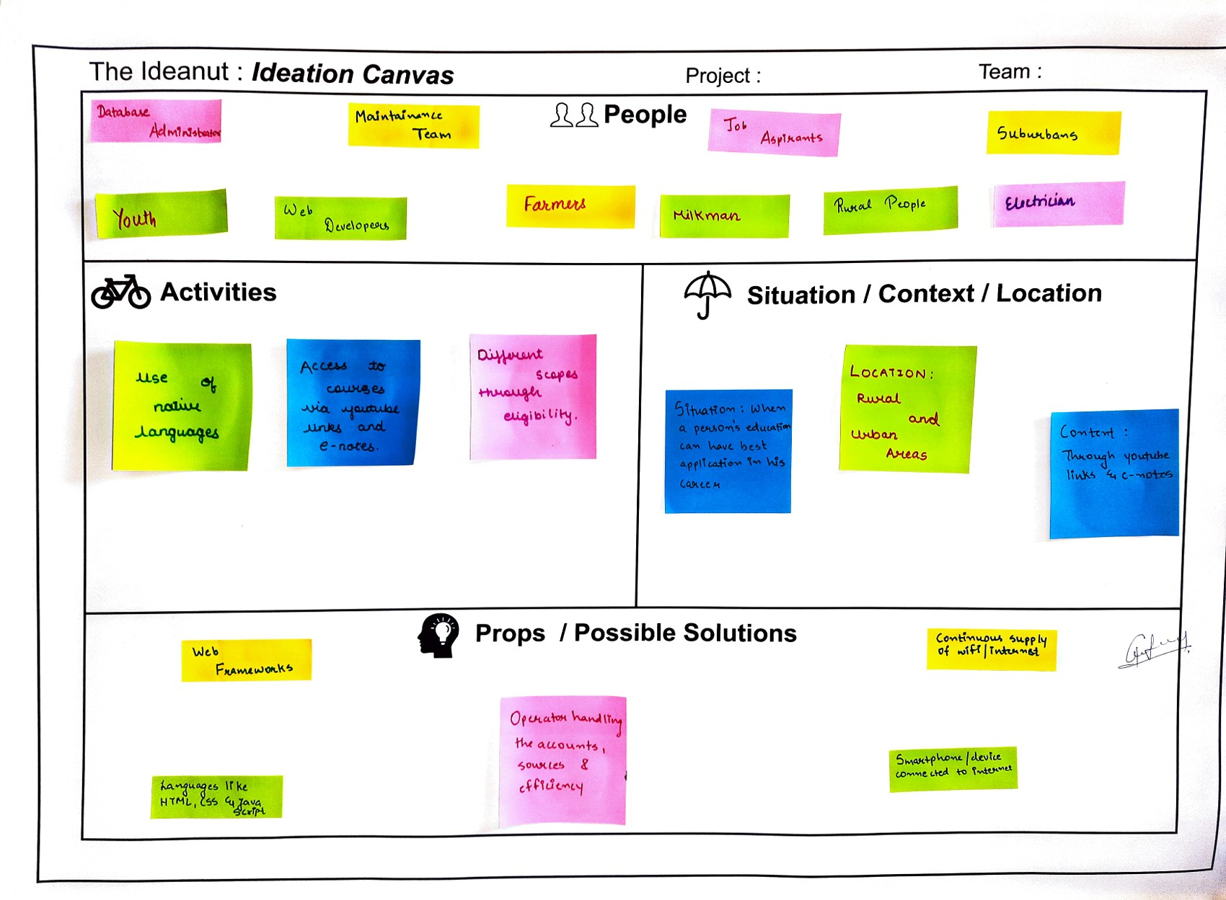
IDEATION CANVAS

Slide 16
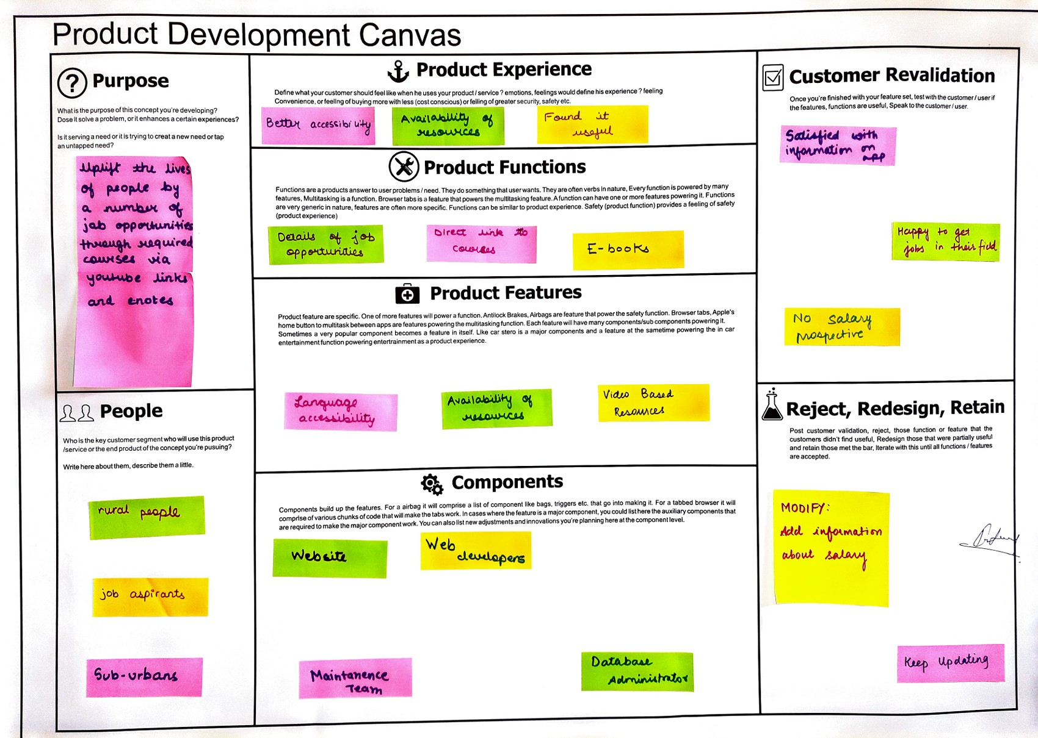
PRODUCT DEVELOPMENT CANVAS

Slide 17
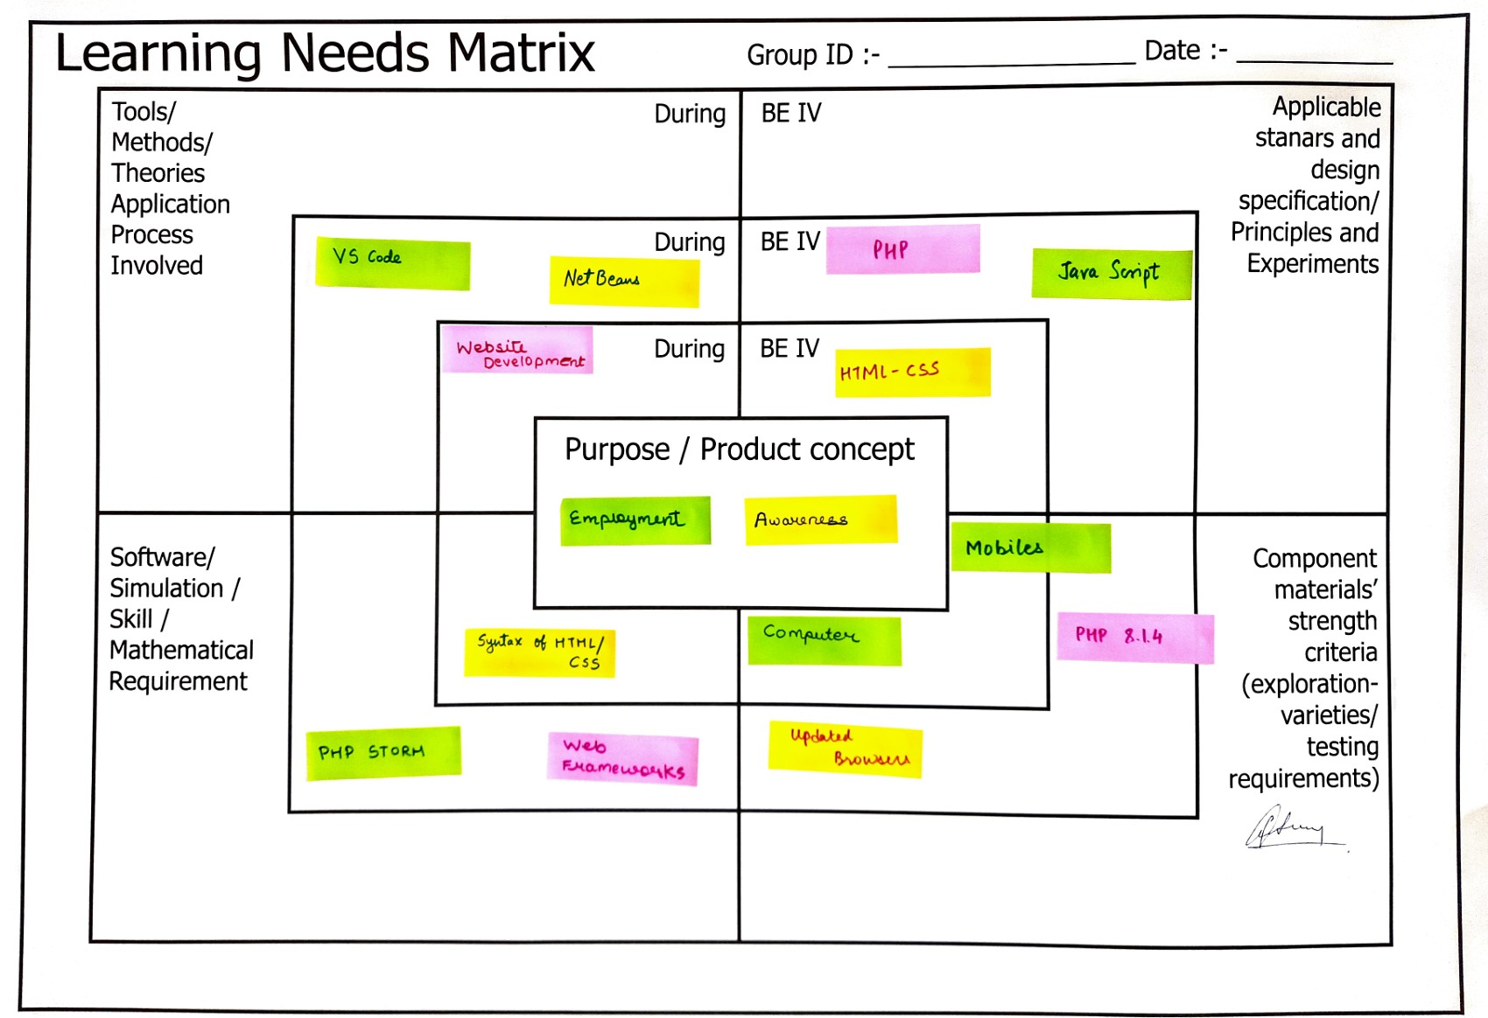
LEARNING NEED MATRIX

Slide 18
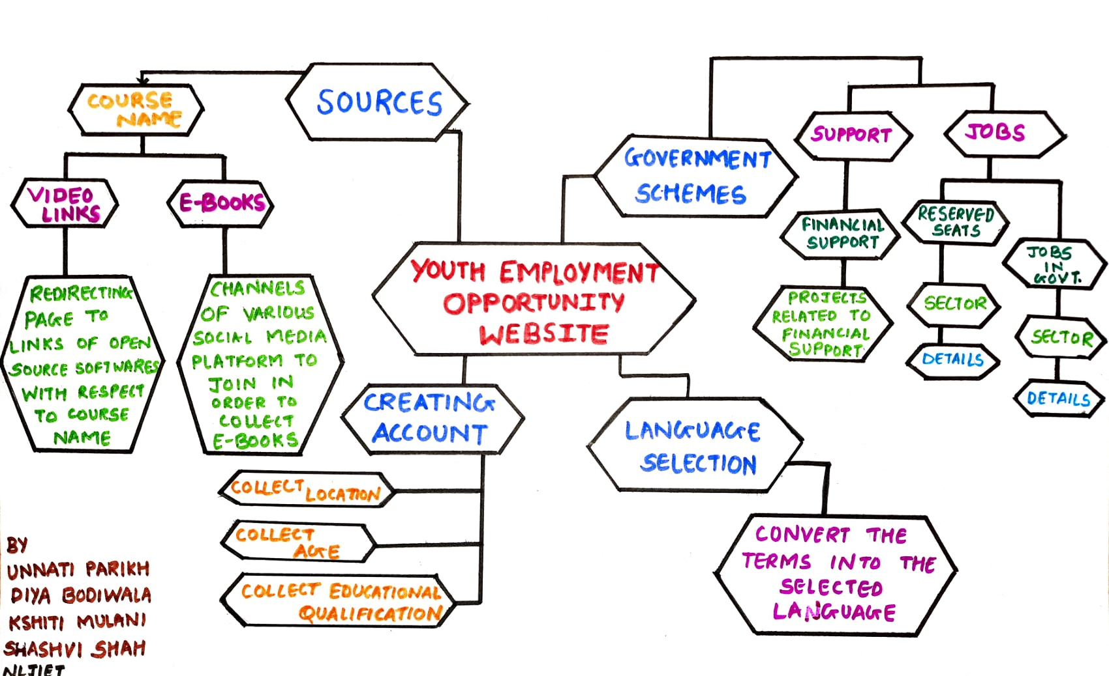
MINDMAP

Slide 19
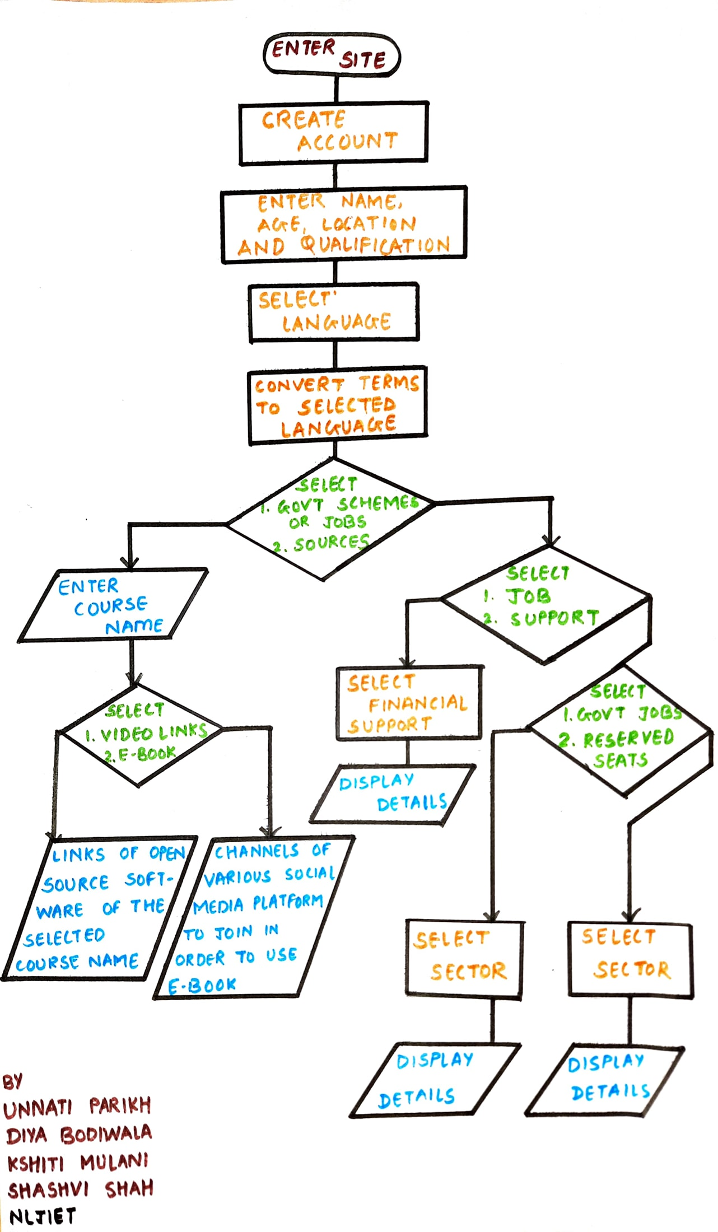
PROTOTYPE
Flowchart

Slide 20
HARDWARE / SOFTWARE REQUIREMENTS
Tools used to develop the website include apps like Visual Studio (latest version to support new developments).
The programming languages required for developing websites include HTML – CSS for frontend and PHP, JavaSript for backend.
Website can be accessed through phones and computers within updated browsers to support the latest developments in the site.

Slide 21
MODULES
Database Administrators – To handle the data and upload it on time.
Web Developers – To develop the website along with the updated features.
Users – Accessing the resources available.
Connection with servers that helps to collect information and resources on timely basis.

Slide 22
FEATURES
Daily updating about the job openings.
Language accessibility.
Conceptual learning through e-books and open-source learning resources
Example: video links, channel links for messages and updates.

Slide 23
LIMITATIONS
No comparison tools available
No salary prospects are mentioned

Slide 24
FUTURE SCOPE
Can include reviews about the work area.
Can include Notification updates.
Can include freelancing and internship facilities.

Slide 25
CONCLUSION
Research studies should be carried out to find what factors can affect the employment status of young people.
Proper skill training should be motivated.
Projects that demand more labour and companies providing numerous opportunities should be given more emphasis.
Hiring, promotion and working conditions without gender discrimination are commendable steps in this direction.

Slide 26
REFERENCES
WEBSITES
[1] E. POLNER, “Best Job Search Websites,” 25 March 2022. [Online]. Available: https://www.thebalancecareers.com/top-best-job-websites-2064080
PAPERS
[3] Fox,Louise & Kaul,Upaasna, 2018. "The evidence is in: how should youth employment programs in low-income countries be designed ?," Policy Research Working Paper Series 8500, The World Bank.
[4]Dr. Mohan A.K, “OPINION OF YOUTH ON ISSUES AND CHALLENGES RELATED TO EMPLOYMENT: A STUDY IN MYSORE CITY” International Journal of Research – Granthaalayah, Vol. 4, No. 4 (2016): 1-7. https://www.cukerala.ac.in/cukpdfs/IQAC/3.4.5/3.4.5.DSW.027.pdf
[5] Shamim Ara (2021). Challenges of Decent Employment in India. Indian Journal of Finance and Economics, Vol. 2, No. 2, pp. 163-185. https://arfjournals.com/image/catalog/Journals%20Papers/IJFE/No%202%20(2021)/5_Shamim_Final.pdf

